Slide 1
IPaT Fall Town Hall
September 1, 2016

Slide 2

Welcome: Chris Jones
Associate VP for Research
IRI 2.0 and CODA Update

Slide 3
IRI 2.0 + CODA Update
IPaT- 5 year review
Held Oct 28-29, 2015​
External panel, plus ad hoc review by faculty and leadership​
Review confirmed that IPaT is a strong organization adding significant value to interdisciplinary research on campus​
Review offered feedback and suggestions for strategic planning for the next 5 year period
Notes:
Life Long Health and Wellbeing
Entries in this category should focus on new or reimagined solutions for patients, communities, and/or those involved in the continuum of care (caregivers, doctors, hospitals, insurers, employers), and might address areas as diverse as chronic disease management; Health IT interoperability; analytics and decision support for quality; safety, and access to care; or advances in pediatric healthcare and healthy aging to name a few.
Smart Cities and Healthy Communities
Entries in this category should focus on solutions for individuals, communities, business and community stakeholders, and government service providers. Solutions might address inclusion, engagement, safety, efficiency, utility, policy, resilience, response, or anything which has the ability to improve the quality of life in communities. While some solutions in this space are geared towards integration of controls, sensors, analytics, and communication with physical elements or services deployed at scale. Other solutions might empower small communities to engage and have impact in novel and agile ways by leveraging, serving, and effecting community members directly.
Socio-Technical Systems and Human-Technology Frontier Innovation
Entries in this category will demonstrate new platforms, services, and devices ranging from the Internet of Things (IoT), Software Defined Networking (SDN), Automotive and Wearable Computing devices, Mixed and Augmented Reality, data science and analytics, collaboration and communication tools. While this category focuses on the technologies themselves entries are expected to demonstrate a viable application or service in order to be competitive.

Slide 4
IRI 1.0
IRIs created to:​
​
Present a cohesive externally facing message about core/priority GT research areas, and deliver a simplified point of entry for outside organizations (companies, foundations, etc.)​
​
Build and manage external research relationships in interdisciplinary areas​
​
Build and coordinate, internally, interdisciplinary research in a targeted research area
Notes:
Life Long Health and Wellbeing
Entries in this category should focus on new or reimagined solutions for patients, communities, and/or those involved in the continuum of care (caregivers, doctors, hospitals, insurers, employers), and might address areas as diverse as chronic disease management; Health IT interoperability; analytics and decision support for quality; safety, and access to care; or advances in pediatric healthcare and healthy aging to name a few.
Smart Cities and Healthy Communities
Entries in this category should focus on solutions for individuals, communities, business and community stakeholders, and government service providers. Solutions might address inclusion, engagement, safety, efficiency, utility, policy, resilience, response, or anything which has the ability to improve the quality of life in communities. While some solutions in this space are geared towards integration of controls, sensors, analytics, and communication with physical elements or services deployed at scale. Other solutions might empower small communities to engage and have impact in novel and agile ways by leveraging, serving, and effecting community members directly.
Socio-Technical Systems and Human-Technology Frontier Innovation
Entries in this category will demonstrate new platforms, services, and devices ranging from the Internet of Things (IoT), Software Defined Networking (SDN), Automotive and Wearable Computing devices, Mixed and Augmented Reality, data science and analytics, collaboration and communication tools. While this category focuses on the technologies themselves entries are expected to demonstrate a viable application or service in order to be competitive.

Slide 5
IRI 1.1 – Circa 2014 (14 points)
IRIs are expected to:
Develop a vision and strategic plan​
Internal Coordination and Facilitation​
Communicate the broad research vision to all members​
Work closely with colleges, schools, IRCs/CTRs, and GTRI to coordinate research efforts in the IRI subject area, including in the support and retention of faculty members in areas related to the IRI’s mission​
Support multiple IRCs and CTRs aligned with the IRI subject area​
Catalyze new research directions, maintain a dynamic research portfolio, and facilitate the formation of interdisciplinary teams, including enabling and incubating the development of new IRCs and CTRs.​
Be inclusive organizations that strive to serve all faculty working in the research theme​
External Partnerships and Thought Leadership​
Coordinate with GTRC and EI2 on economic development activities​
Act as an effective focal point for interactions with external partners in the IRI focus area​
Organize and articulate national and international thought leadership in the IRI subject area​
Enable the creation of funding opportunities through policy participation and leadership in the development of national and state science and technology priorities​
Resource and Facility Management​
Facilitate use of shared (personnel and physical) resources ​
Manage and support research space, including core resources and facilities, as appropriate to the research field (*** If not relevant to IPAT, will not be a component of the review***)​
Provide staff support and other resources to facilitate the development of large-scale multi-investigator extramural grant proposals​
Provide seed funding opportunities for new research ideas
Notes:
Life Long Health and Wellbeing
Entries in this category should focus on new or reimagined solutions for patients, communities, and/or those involved in the continuum of care (caregivers, doctors, hospitals, insurers, employers), and might address areas as diverse as chronic disease management; Health IT interoperability; analytics and decision support for quality; safety, and access to care; or advances in pediatric healthcare and healthy aging to name a few.
Smart Cities and Healthy Communities
Entries in this category should focus on solutions for individuals, communities, business and community stakeholders, and government service providers. Solutions might address inclusion, engagement, safety, efficiency, utility, policy, resilience, response, or anything which has the ability to improve the quality of life in communities. While some solutions in this space are geared towards integration of controls, sensors, analytics, and communication with physical elements or services deployed at scale. Other solutions might empower small communities to engage and have impact in novel and agile ways by leveraging, serving, and effecting community members directly.
Socio-Technical Systems and Human-Technology Frontier Innovation
Entries in this category will demonstrate new platforms, services, and devices ranging from the Internet of Things (IoT), Software Defined Networking (SDN), Automotive and Wearable Computing devices, Mixed and Augmented Reality, data science and analytics, collaboration and communication tools. While this category focuses on the technologies themselves entries are expected to demonstrate a viable application or service in order to be competitive.

Slide 6
DRAFT IRI 2.0
Concise IRI 2.0 description (for external communication):​
​
An Interdisciplinary Research Institute (IRI) provides a focal point for Georgia Tech’s interdisciplinary research and transition activities in strategic focus areas. It serves as steward for Georgia Tech’s thought leadership role in this area and as such helps develop, support, and facilitate interdisciplinary sponsored research across all Georgia Tech schools and research units, and provides an important, but not exclusive, gateway for industry collaboration and sponsorship. The IRI may also provide shared research space, equipment and administrative services. The number of IRI’s and their strategic focus areas will evolve with Georgia Tech’s grand challenge areas of interest for transformative impact on society and the economy.
Notes:
Life Long Health and Wellbeing
Entries in this category should focus on new or reimagined solutions for patients, communities, and/or those involved in the continuum of care (caregivers, doctors, hospitals, insurers, employers), and might address areas as diverse as chronic disease management; Health IT interoperability; analytics and decision support for quality; safety, and access to care; or advances in pediatric healthcare and healthy aging to name a few.
Smart Cities and Healthy Communities
Entries in this category should focus on solutions for individuals, communities, business and community stakeholders, and government service providers. Solutions might address inclusion, engagement, safety, efficiency, utility, policy, resilience, response, or anything which has the ability to improve the quality of life in communities. While some solutions in this space are geared towards integration of controls, sensors, analytics, and communication with physical elements or services deployed at scale. Other solutions might empower small communities to engage and have impact in novel and agile ways by leveraging, serving, and effecting community members directly.
Socio-Technical Systems and Human-Technology Frontier Innovation
Entries in this category will demonstrate new platforms, services, and devices ranging from the Internet of Things (IoT), Software Defined Networking (SDN), Automotive and Wearable Computing devices, Mixed and Augmented Reality, data science and analytics, collaboration and communication tools. While this category focuses on the technologies themselves entries are expected to demonstrate a viable application or service in order to be competitive.

Slide 7
Draft IRI 2.0 – Circa 2017 (10 Points)
IRIs are expected to:​
• Develop a vision and strategic plan​
Internal Coordination and Facilitation​
• Communicate the broad research vision to all members​
• Work closely with colleges, schools, IRCs/CTRs, and GTRI to coordinate research efforts in the IRI subject area, including in the support and retention of faculty members in areas related to the IRI’s mission​
• Catalyze new research directions, maintain a dynamic research portfolio, and facilitate the formation of interdisciplinary teams, including enabling and incubating the development of new IRCs and CTRs​
External Partnerships and Thought Leadership​
• Act as an effective focal point for interactions with external partners in the IRI focus area​
• Organize and articulate national and international thought leadership in the IRI subject area​
• Enable the creation of funding opportunities through policy participation and leadership in the development of national and state science and technology priorities​
• Coordinate with GTRC, EI2 and Government Relations on (i) research and development, (ii) technology commercialization, and (iii) economic development and entrepreneurship​
Resource and Facility Management​
• Provide leadership and resources to facilitate the development of large-scale multi-investigator extramural grant proposals​
• Manage and support research space, including core resources and facilities, as appropriate to the research field
Notes:
Life Long Health and Wellbeing
Entries in this category should focus on new or reimagined solutions for patients, communities, and/or those involved in the continuum of care (caregivers, doctors, hospitals, insurers, employers), and might address areas as diverse as chronic disease management; Health IT interoperability; analytics and decision support for quality; safety, and access to care; or advances in pediatric healthcare and healthy aging to name a few.
Smart Cities and Healthy Communities
Entries in this category should focus on solutions for individuals, communities, business and community stakeholders, and government service providers. Solutions might address inclusion, engagement, safety, efficiency, utility, policy, resilience, response, or anything which has the ability to improve the quality of life in communities. While some solutions in this space are geared towards integration of controls, sensors, analytics, and communication with physical elements or services deployed at scale. Other solutions might empower small communities to engage and have impact in novel and agile ways by leveraging, serving, and effecting community members directly.
Socio-Technical Systems and Human-Technology Frontier Innovation
Entries in this category will demonstrate new platforms, services, and devices ranging from the Internet of Things (IoT), Software Defined Networking (SDN), Automotive and Wearable Computing devices, Mixed and Augmented Reality, data science and analytics, collaboration and communication tools. While this category focuses on the technologies themselves entries are expected to demonstrate a viable application or service in order to be competitive.

Slide 8
CODA Update
IPaT demonstrated excellent leadership in helping to shape numerous neighborhoods:​
Health, Internet of Things, Smart Cities​
Thank you!!​
CODA FSG providing potential occupancy plans to Deans/EVPs in September​
Neighborhoods to start working with interior design firm now​
Primary occupancy plan expected mid-October
Notes:
Life Long Health and Wellbeing
Entries in this category should focus on new or reimagined solutions for patients, communities, and/or those involved in the continuum of care (caregivers, doctors, hospitals, insurers, employers), and might address areas as diverse as chronic disease management; Health IT interoperability; analytics and decision support for quality; safety, and access to care; or advances in pediatric healthcare and healthy aging to name a few.
Smart Cities and Healthy Communities
Entries in this category should focus on solutions for individuals, communities, business and community stakeholders, and government service providers. Solutions might address inclusion, engagement, safety, efficiency, utility, policy, resilience, response, or anything which has the ability to improve the quality of life in communities. While some solutions in this space are geared towards integration of controls, sensors, analytics, and communication with physical elements or services deployed at scale. Other solutions might empower small communities to engage and have impact in novel and agile ways by leveraging, serving, and effecting community members directly.
Socio-Technical Systems and Human-Technology Frontier Innovation
Entries in this category will demonstrate new platforms, services, and devices ranging from the Internet of Things (IoT), Software Defined Networking (SDN), Automotive and Wearable Computing devices, Mixed and Augmented Reality, data science and analytics, collaboration and communication tools. While this category focuses on the technologies themselves entries are expected to demonstrate a viable application or service in order to be competitive.

Slide 9
Back Up Slides
Specific changes:​
Internal Coordination and Facilitation​
Deleted: Support multiple IRCs and CTRs aligned with the IRI subject area.​
Did not score well in team ratings; Majority felt that all IRIs do not need to explicitly do this​
Deleted: Be inclusive organizations that strive to serve all faculty working in the research theme.​
Did not score well in team ratings. The EVPR office continues to hope IRIs will strive to be inclusive, but we understand that it is not always possible in the time and resource constrained world in which we operate.​
External Partnerships and Thought Leadership​
Reworded 8 to be more explicit based on group 3 input: Coordinate with GTRC, EI2 and Government Relations on (i) research and development, (ii) technology commercialization, and (iii) economic development and entrepreneurship​
Was: Coordinate with GTRC and EI2 on economic development activities.​
Resource and Facility Management​
Reworded 9: Provide leadership and resources to facilitate the development of large-scale multi-investigator extramural grant proposals. ​
Was: Provide staff support and other resources to facilitate the development of large-scale multi-investigator extramural grant proposals​
Deleted: Facilitate use of shared (personnel and physical) resources ​
Believe this is superfluous to 9 and 10.​
Deleted: Provide seed funding opportunities for new research ideas****​
Believe this is non-explicitly covered under objective 4.
Notes:
Life Long Health and Wellbeing
Entries in this category should focus on new or reimagined solutions for patients, communities, and/or those involved in the continuum of care (caregivers, doctors, hospitals, insurers, employers), and might address areas as diverse as chronic disease management; Health IT interoperability; analytics and decision support for quality; safety, and access to care; or advances in pediatric healthcare and healthy aging to name a few.
Smart Cities and Healthy Communities
Entries in this category should focus on solutions for individuals, communities, business and community stakeholders, and government service providers. Solutions might address inclusion, engagement, safety, efficiency, utility, policy, resilience, response, or anything which has the ability to improve the quality of life in communities. While some solutions in this space are geared towards integration of controls, sensors, analytics, and communication with physical elements or services deployed at scale. Other solutions might empower small communities to engage and have impact in novel and agile ways by leveraging, serving, and effecting community members directly.
Socio-Technical Systems and Human-Technology Frontier Innovation
Entries in this category will demonstrate new platforms, services, and devices ranging from the Internet of Things (IoT), Software Defined Networking (SDN), Automotive and Wearable Computing devices, Mixed and Augmented Reality, data science and analytics, collaboration and communication tools. While this category focuses on the technologies themselves entries are expected to demonstrate a viable application or service in order to be competitive.

Slide 10
IPaT Highlights

Slide 11
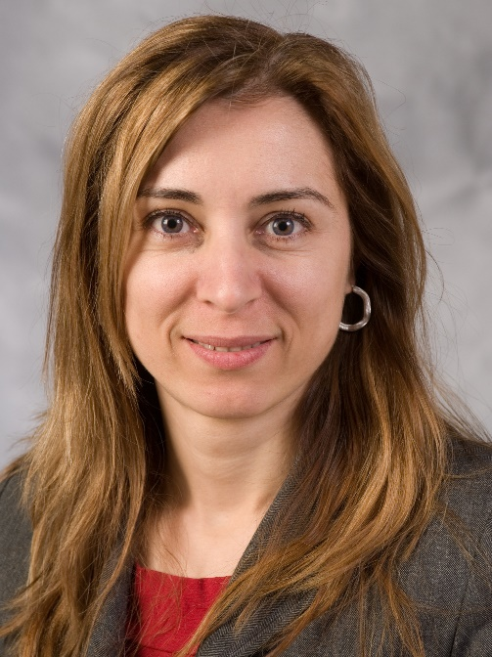
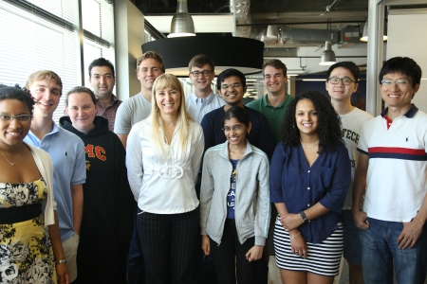
IPaT Highlights
Nicoleta Serban
Access to dental care for Georgia children
P30 Translational Diabetes Research Center
Emory + Arriaga, Serban, Mynatt, Wang, Wilcox
Leadership Excellence
2 of 5 GT Awards: Mynatt, Farrugia
DHS CIRI Center of Excellence: McCook
New Industry Partner: ThyssenKrupp (TK)
Over $350K. Future office environments
(Re)New Industry Partner: Ford
Platforms for early design of complex systems
MODA Exhibit: On You Wearing Technology
Zeagler, Starner, and many more
Take Me Out To the Ball Game
Braves. Georgia Tech. STEM Education

Slide 12

IPaT Highlights
Nicoleta Serban
Access to dental care for Georgia children
P30 Translational Diabetes Research Center
Emory + Arriaga, Serban, Mynatt, Wang, Wilcox
Leadership Excellence
2 of 5 GT Awards: Mynatt, Farrugia
DHS CIRI Center of Excellence: McCook
New Industry Partner: ThyssenKrupp (TK)
Over $350K. Future office environments
(Re)New Industry Partner: Ford
Platforms for early design of complex systems
MODA Exhibit: On You Wearing Technology
Zeagler, Starner, and many more
Take Me Out To the Ball Game
Braves. Georgia Tech. STEM Education
Notes:
Need pic of Emory ☺

Slide 13
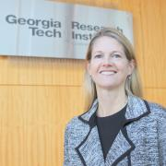
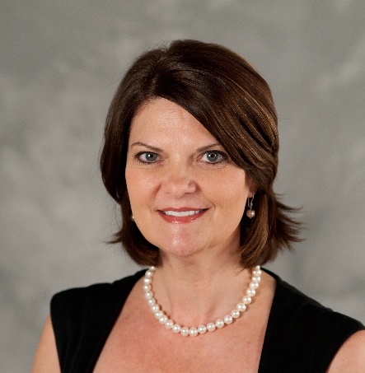
IPaT Highlights
Nicoleta Serban
Access to dental care for Georgia children
P30 Translational Diabetes Research Center
Emory + Arriaga, Serban, Mynatt, Wang, Wilcox
Leadership Excellence
2 of 5 GT Awards: Mynatt, Farrugia
DHS CIRI Center of Excellence: McCook
New Industry Partner: ThyssenKrupp (TK)
Over $350K. Future office environments
(Re)New Industry Partner: Ford
Platforms for early design of complex systems
MODA Exhibit: On You Wearing Technology
Zeagler, Starner, and many more
Take Me Out To the Ball Game
Braves. Georgia Tech. STEM Education
Notes:
Need headshots of Farrugia and McCook
Critical Infrastructure Resiliency Institute (CIRI)

Slide 14
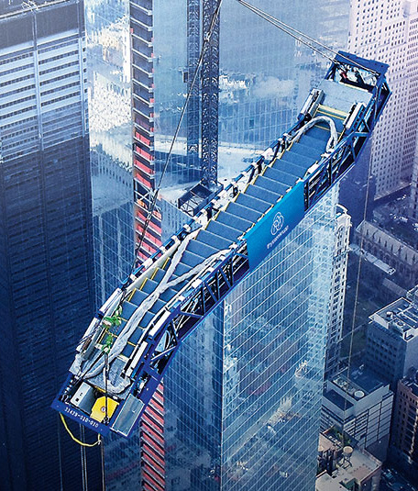
IPaT Highlights
Nicoleta Serban
Access to dental care for Georgia children
P30 Translational Diabetes Research Center
Emory + Arriaga, Serban, Mynatt, Wang, Wilcox
Leadership Excellence
2 of 5 GT Awards: Mynatt, Farrugia
DHS CIRI Center of Excellence: McCook
New Industry Partner: ThyssenKrupp (TK)
Over $350K. Future office environments
(Re)New Industry Partner: Ford
Platforms for early design of complex systems
MODA Exhibit: On You Wearing Technology
Zeagler, Starner, and many more
Take Me Out To the Ball Game
Braves. Georgia Tech. STEM Education

Slide 15
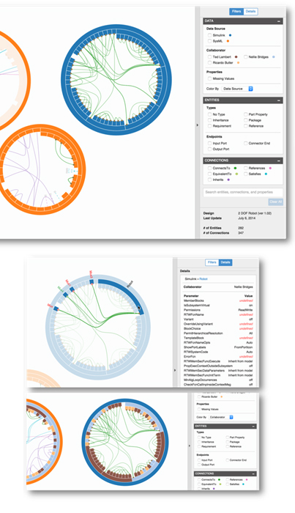
IPaT Highlights
Nicoleta Serban
Access to dental care for Georgia children
P30 Translational Diabetes Research Center
Emory + Arriaga, Serban, Mynatt, Wang, Wilcox
Leadership Excellence
2 of 5 GT Awards: Mynatt, Farrugia
DHS CIRI Center of Excellence: McCook
New Industry Partner: ThyssenKrupp (TK)
Over $350K. Future office environments
(Re)New Industry Partner: Ford
Platforms for early design of complex systems
MODA Exhibit: On You Wearing Technology
Zeagler, Starner, and many more
Take Me Out To the Ball Game
Braves. Georgia Tech. STEM Education

Slide 16

IPaT Highlights
Nicoleta Serban
Access to dental care for Georgia children
P30 Translational Diabetes Research Center
Emory + Arriaga, Serban, Mynatt, Wang, Wilcox
Leadership Excellence
2 of 5 GT Awards: Mynatt, Farrugia
DHS CIRI Center of Excellence: McCook
New Industry Partner: ThyssenKrupp (TK)
Over $350K. Future office environments
(Re)New Industry Partner: Ford
Platforms for early design of complex systems
MODA Exhibit: On You Wearing Technology
Zeagler, Starner, and many more
Take Me Out To the Ball Game
Braves. Georgia Tech. STEM Education

Slide 17

IPaT Highlights
Nicoleta Serban
Access to dental care for Georgia children
P30 Translational Diabetes Research Center
Emory + Arriaga, Serban, Mynatt, Wang, Wilcox
Leadership Excellence
2 of 5 GT Awards: Mynatt, Farrugia
DHS CIRI Center of Excellence: McCook
New Industry Partner: ThyssenKrupp (TK)
Over $350K. Future office environments
(Re)New Industry Partner: Ford
Platforms for early design of complex systems
MODA Exhibit: On You Wearing Technology
Zeagler, Starner, and many more
Take Me Out To the Ball Game
Braves. Georgia Tech. STEM Education

Slide 18

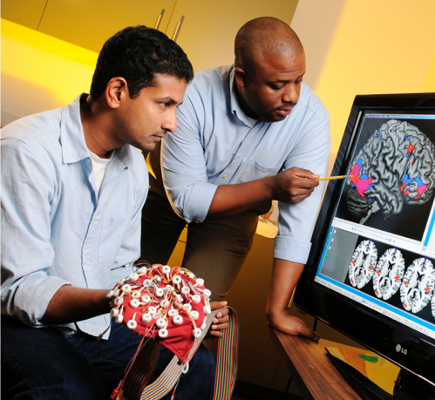
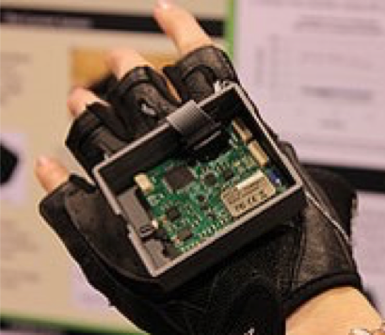
GVU / IPaT Research & Engagement Grants
Collision of Creatives
Laura Levy, Interactive Media Technology Center
Maribeth Gandy, Interactive Media Technology Center
Clint Zeagler, Wearable Computing Center
Madison Cario, Arts@Tech
Lane Conville-Canney, Arts@Tech
Wayne Li, School of Industrial Design
(T)racing Eyes and Hearts: An Installation to Reflect on the Physiology of Empathy
Anne Pollock, School of Literature, Media, and Communication
Lewis Wheaton, School of Applied Physiology
Nassim JafariNaimi, School of Literature, Media, and Communication
Passive Haptic Rehabilitation for Stroke
Thad Starner, School of Interactive Computing
Steve Wolf, Emory University's Department of Rehabilitation Medicine

Slide 19
CTPHD (Pediatric) Seed Grants
Development of a Predictive Clinical Model for Concussion Recovery in Children
and Adolescents Who Experience Persistent Concussion Symptoms
Michelle C. LaPlaca, Georgia Institute of Technology
Barbara Weissman, Emory University
May Wang, Georgia Institute of Technology
Determination of the Barriers to the Application of Hematopoietic Stem Cell
Transplantation for the Cure of Sickle Cell Disease
Lakshmanan Krishnamurti, Emory University
Nicoleta Serban, Georgia Institute of Technology
Assessing Quality of Care in a Community-Based Autism Clinic
Jennifer S. Singh, Georgia Institute of Technology
Leslie Rubin, Morehouse School of Medicine
Pediatric Asthma Outcome Prediction Using Clinical, Environmental and Social Economic Information
Jimeng Sun, Georgia Institute of Technology
Javier Tejedor-Sojo, Children's Healthcare of Atlanta
Elizabeth Searles, Children's Healthcare of Atlanta
James Bost, Children's Healthcare of Atlanta

Slide 20

Geisinger Health System Seed Grant Program
Heart Track: Software to Predict Diagnosis, Therapy and Outcomes From Heart Images
Jim Rehg, Georgia Institute of Technology
Jimeng Sun, Georgia Institute of Technology
Brandon Fornwalt, Geisinger Health System
Development of an Operational Decision Support Tool for Biologic Pharmaceutical Use in Chronic Disease Management
Turgay Ayer, ISyE, Georgia Institute of Technology
Seth Hostetler, Geisinger Health System
Identification of Genes and Diseases Associated with Developmental Robustness
Annalise Paaby, Georgia Institute of Technology
Sarah Pendergrass, Geisinger Health System

Slide 21

Strategic Planning: Overview
Every 5 years….
Vision, Mission and Priorities
and now Values
Emergent
Research priorities
Every Year
Implementation Plan
IPaT Office Hours
Annual report
Personal eval and plans

Slide 22
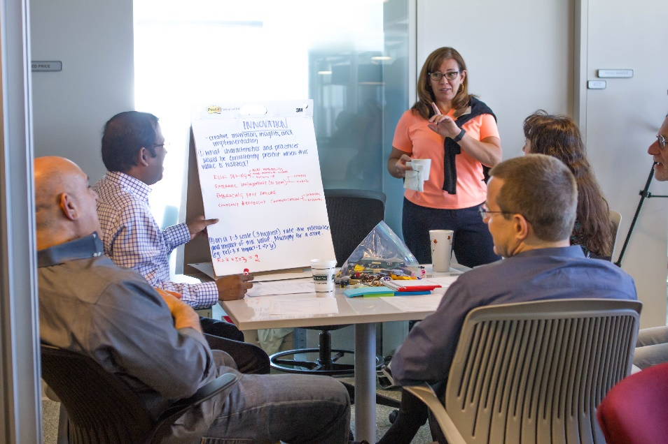
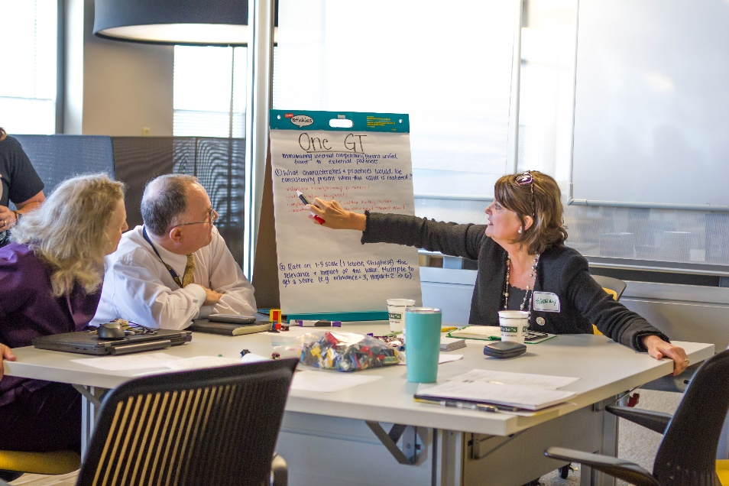
Strategic Planning: Overview
We’re in a really good place
Values
Vision
Mission
Priorities
Implementation Plan
Faculty Retreat: May 2016
Staff Retreat: June 2016
Management Retreat: August 2016
Increase coordination
Decrease friction
Train your internal compass

Slide 23
Core Values
Notes:
REPLACE based on values discussion

Slide 24
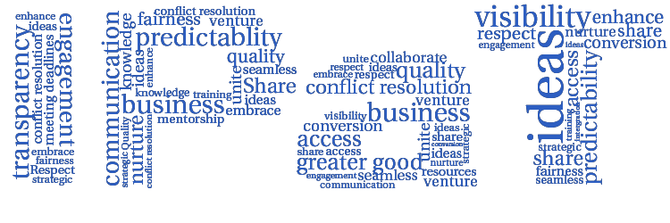
Core Values
One GT
Trusted partner
Innovation
Diversity
Notes:
REPLACE based on values discussion

Slide 25
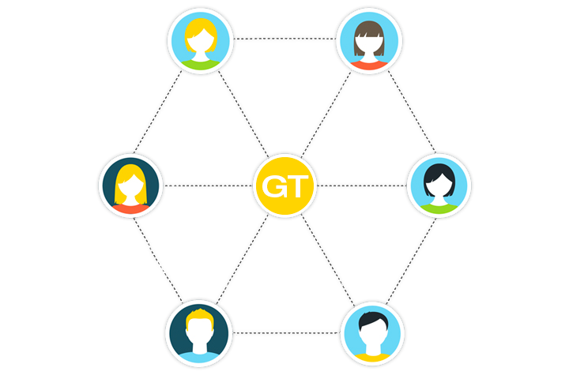
Core Values
One GT
We will operate collaboratively by sharing knowledge and resources, all for the greater good of Georgia Tech.

Slide 26

Core Values
Trusted Partner
We will be transparent, meet deadlines, and work together to enhance and grow valuable relationships on and off campus.

Slide 27

Core Values
Innovation
We will support a culture
of creativity, thought leadership and boundary-pushing ideas, and be unafraid of failure.

Slide 28

Core Values
Diversity
We will recognize, respect, and embrace inclusion and fairness throughout all aspects of our research, practice and operations.

Slide 29
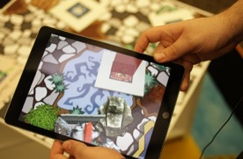
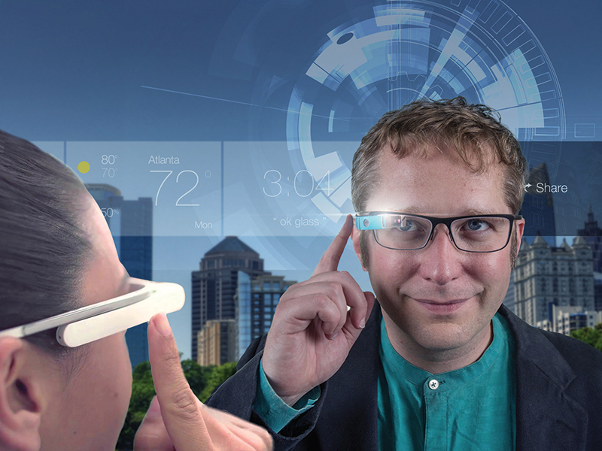
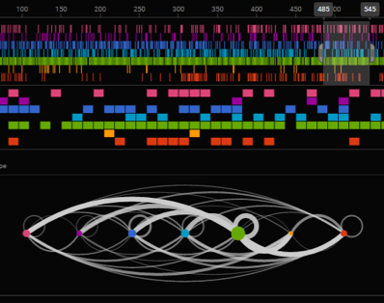
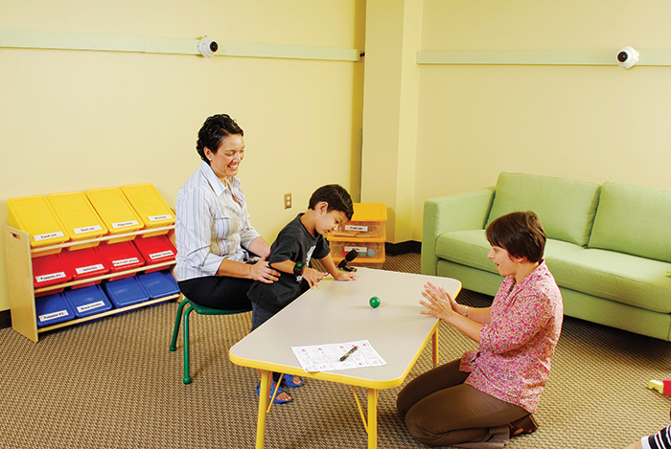
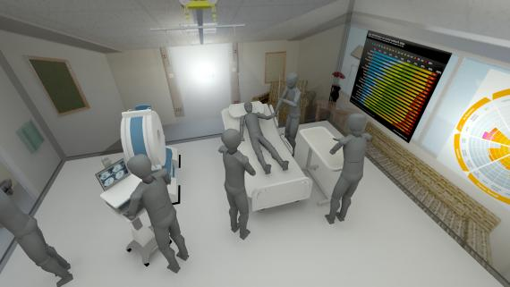
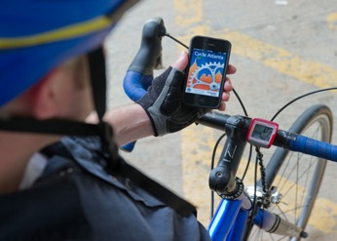
IPaT’s Vision
Shaping the future of human-centered systems, environments and technologies to promote satisfying, healthy and productive lives.
Notes:
Need some visual treatment here

Slide 30

IPaT’s Mission
Catalyze interdisciplinary research between faculty, students, and industry.
Provide the continuity and capacity to address societal challenges.
Advocate for socio-technical change that improves the human condition.
Educate human-centered engineers, scientists, designers, business leaders, and policy makers.

Slide 31
Key IPaT Priorities
Develop and communicate the vision, strategic plan and capabilities of GT
Be a focal point for interaction with external partners
Catalyze new research directions, maintain a dynamic research portfolio, and facilitate the formation of interdisciplinary teams.
Organize and articulate national and international thought leadership.
Provide leadership and resources to facilitate the development of large-scale, multi-investigator research programs.
Work closely with colleges, schools, other IRIs and research centers to ensure research capacity and excellence.
Assist in the development of national and state research and economic development priorities.

Slide 32
IPaT Research Priorities

Slide 33
IPaT Research Priorities
Life Long Health and Wellbeing
Smart Cities and Healthy Communities
Platforms and Services for Socio-Technical Systems
Shaping the Human Technology Frontier
Notes:
Need visual here

Slide 34

Life Long Health and Wellbeing
Healthy Aging
Pediatric Healthcare Delivery
Healthcare Delivery, Access and Disparities
Mobile Health & Social Computing
Healthcare Environments
Universal Access & Assistive Tech
Aware Home
Protected Health Data Infrastructure
Pediatric Technology Center
CHHS
TechSAge RERC
Wireless RERC
SimTigrate
Health Analytics + GTRI Strategic Initiative
Interoperability Innovation Lab
Employers Like Me
CREATE
CATEA

Slide 35

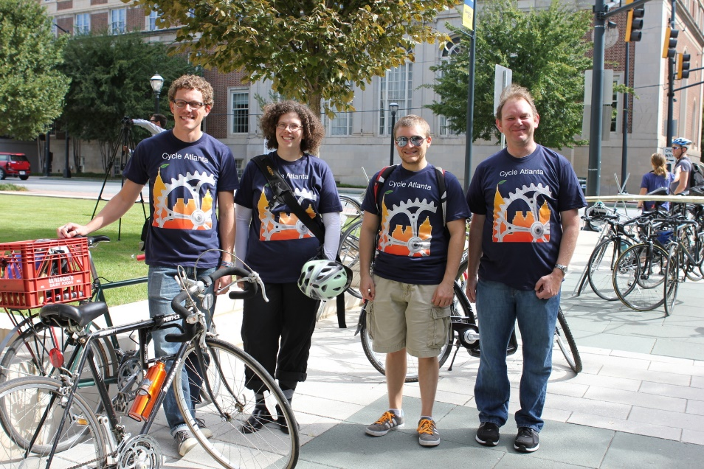
Smart Cities and Healthy Communities
Resilience and Response
Urban Innovation
Community Engagement
Efficient Transportation
Public Safety
Center Health Humanitarian Systems
Smart ATL
CoA Urban Security Initiative
Center for Urban Innovation
MetroLab
GT Mobile / GT Journey
GTRI Smart City Strategic Initiative
Cycle Atlanta / OneBusAway / Trolley
Campus Life / Savannah / Panama
Midtown Buzz & CODA

Slide 36

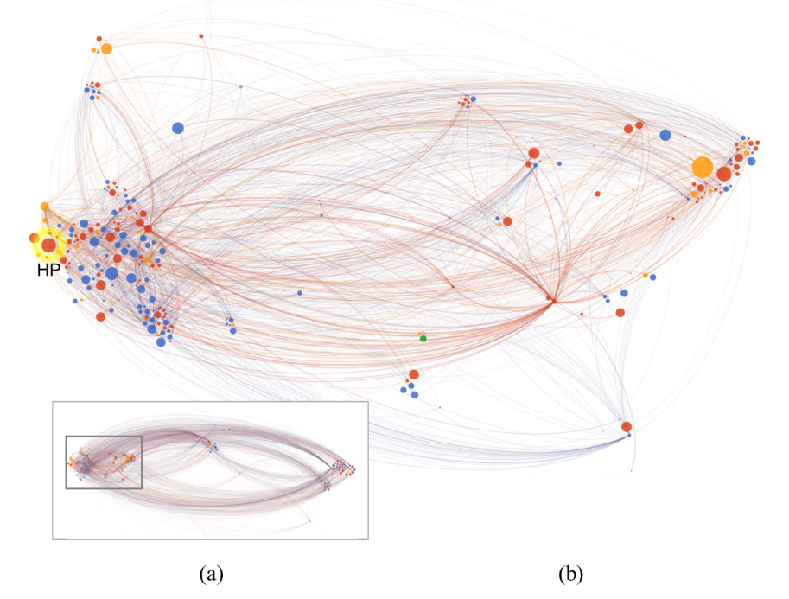
Platforms and Services for
Socio-Technical Systems
Analytics for healthcare, diagnosis, delivery and efficiency
Enterprise simulation and transformation
IoT / Software defined networking
Social computing analytics
Visual analytics
Tennenbaum Institute
CDAIT
Healthcare Analytics
CHHS
GENI / SDX Sox / Atlantic Wave
dot.net
GT Journey / Midtown Buzz
Notes:
Need a Rahul visualization here

Slide 37

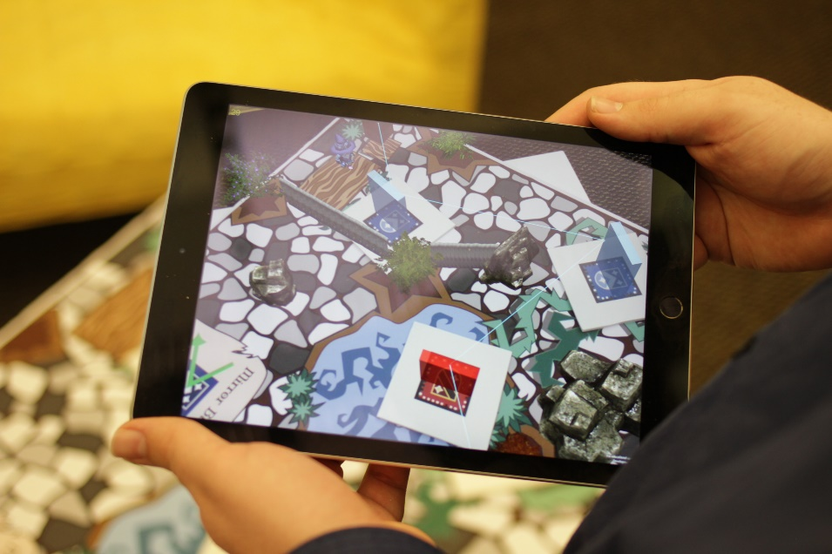
Shaping the Human Technology Frontier
Augmenting human capabilities
Mixed and augmented reality
Visual analytics
Human – Animal interaction
Arts and technology
Universal design & Assistive Technology
Wearable Computing Center
GVU Center
Wireless RERC
TechSAge RERC
CATEA
Argon
Magic Window
DART
Wearables “swatch book”

Slide 38
IPaT Research Priorities
Life Long Health and Wellbeing
Smart Cities and Healthy Communities
Platforms and Services for Socio-Technical Systems
Shaping the Human Technology Frontier
Notes:
Need visual here

Slide 39
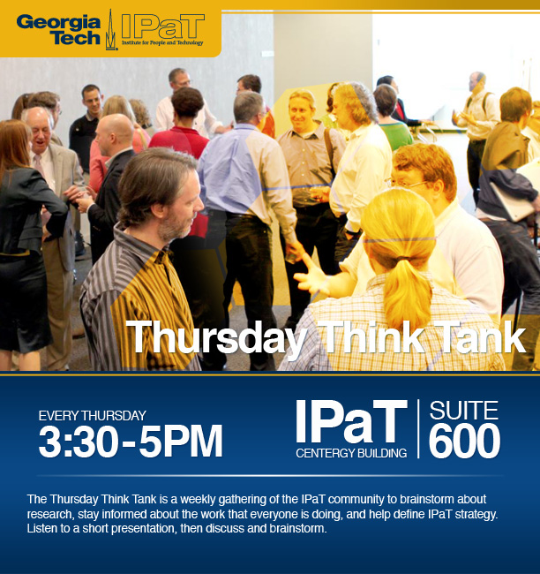
Thursday Think Tanks
The TTT is a weekly gathering
of the IPaT community to brainstorm about research,
stay informed about the work that everyone is doing, and
help define IPaT strategy.
Come interact with new and old colleagues and engage on topics of shared interest.

Slide 40
Thursday Think Tank Schedule (Thurs, 3:30-5pm)
Topic | Date
Smart Cities and Healthy Communities | Sept 8
Lifelong Health and Wellbeing | Sept 15
Shaping the New Human Frontier | Sept 22
Platforms and Services for Socio-Technical Systems | Sept 29

Slide 41

IPaT Strategic Partnerships
Foster new initiatives and cross-campus collaborations​
Focus on IPAT research priorities​
Convene monthly faculty councils
Tuesdays & Thursdays
Lunch, Learn, and Share

Slide 42
IPaT Strategic Partnerships
Health and Wellbeing​
Pediatric: tbd & Sherry Farrugia​
Aging: Brian Jones & Jon Sanford​
Smart Cities and Connected Communities
Urban Systems: Russ Clark & Jennifer Clark​
Health & Humanitarian: Leigh McCook & Pinar​ Keskinocak
Socio-Technical Platforms and Services​
Enterprise and Health Analytics:- Rahul Basole & Jon Duke​
IoT– Russ Clark & tbd​
Human Technology Frontier​
Wearables/AR/VR:- Maribeth Gandy & tbd

Slide 43
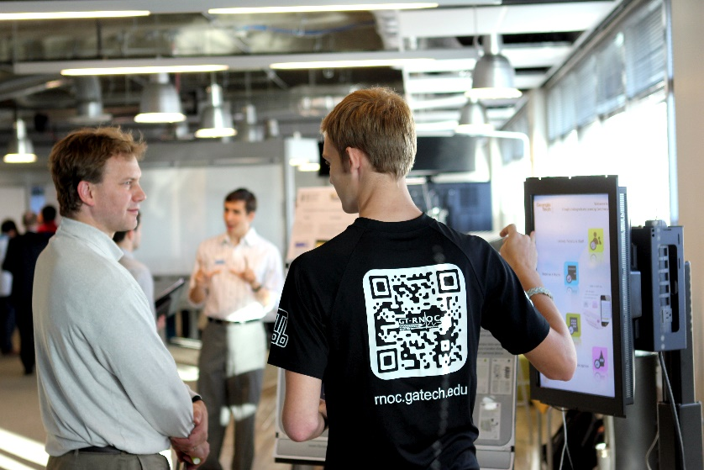
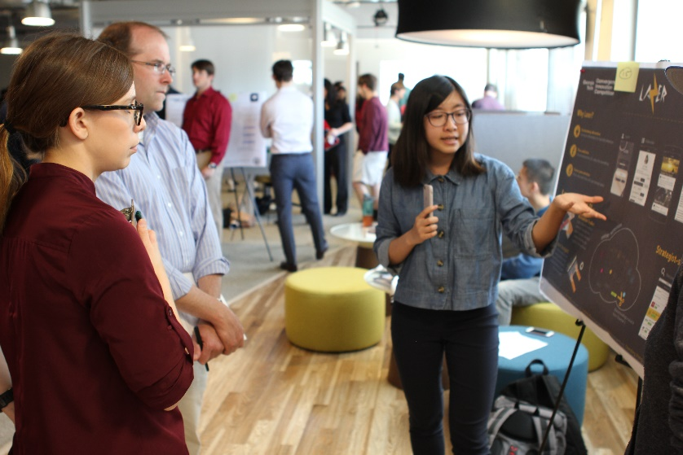
Convergence Innovation Competition
Bi-Annual competition
Over 100 students annually
2016 Fall CIC – November 16th
Categories:
Lifelong Health and Wellbeing
Smart Cities and Healthy Communities
Socio-Technical Systems and Human-Technology Frontier Innovation
Onboarding sponsors right now
Past sponsors include Verizon, AT&T, Cisco,
Code 42, and GM
Notes:
Life Long Health and Wellbeing
Entries in this category should focus on new or reimagined solutions for patients, communities, and/or those involved in the continuum of care (caregivers, doctors, hospitals, insurers, employers), and might address areas as diverse as chronic disease management; Health IT interoperability; analytics and decision support for quality; safety, and access to care; or advances in pediatric healthcare and healthy aging to name a few.
Smart Cities and Healthy Communities
Entries in this category should focus on solutions for individuals, communities, business and community stakeholders, and government service providers. Solutions might address inclusion, engagement, safety, efficiency, utility, policy, resilience, response, or anything which has the ability to improve the quality of life in communities. While some solutions in this space are geared towards integration of controls, sensors, analytics, and communication with physical elements or services deployed at scale. Other solutions might empower small communities to engage and have impact in novel and agile ways by leveraging, serving, and effecting community members directly.
Socio-Technical Systems and Human-Technology Frontier Innovation
Entries in this category will demonstrate new platforms, services, and devices ranging from the Internet of Things (IoT), Software Defined Networking (SDN), Automotive and Wearable Computing devices, Mixed and Augmented Reality, data science and analytics, collaboration and communication tools. While this category focuses on the technologies themselves entries are expected to demonstrate a viable application or service in order to be competitive.

Slide 44
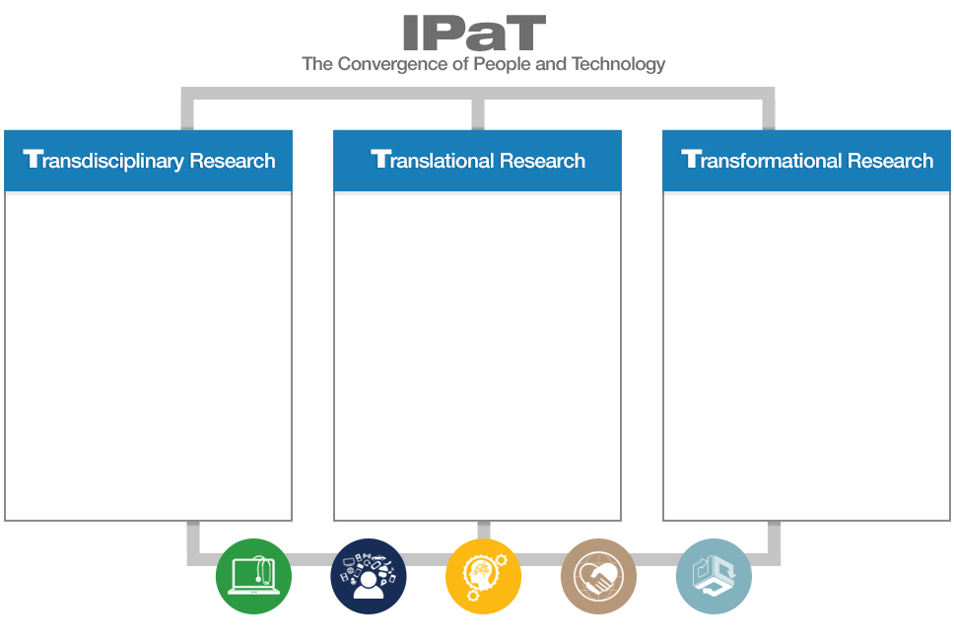



IPaT’s 3T Approach
Trans-disciplinary research works hand in hand with applied research, education and training, economic development and outreach to achieve transformational leadership.

Slide 45
Breakout Groups
Lifelong Health and Wellbeing (GTRI 617)
Brad Fain - Georgia Tech Research Institute, HomeLab
Wendy Rogers - School of Psychology
Jon Sanford - College of Design, Center for Assistive Technology and Environmental Access
Platforms and Services for Socio-Technical Systems (Yellow Jacket)
Rahul Basole - Tennenbaum Institute
Margaret Wagner Dahl - Enterprise Innovation Institute
Jon Duke - School of Computational Science and Engineering
Richard Starr - Institute for People and Technology
Julie Swann - School of Industrial & Systems Engineering
Smart Cities and Healthy Communities (Open Area East)
Gregory Abowd - School of Interactive Computing
Jennifer Clark - School of Public Policy, Center for Urban Innovation
Margaret Loper - Georgia Tech Research Institute
Matt Sanders - Research Network Operations Center
Shaping the New Human-Technology Frontier (Burdell)
Paul Baker - Center for Advanced Communications Policy
Maribeth Gandy - Interactive Media Technology Center
Clint Zeagler - Wearable Computing Center

Slide 46
IPaT Fall Schedule
Hosted by Research Centers
Health Systems:
The Next Generation Sept 16
Workshop:
Healthy Aging Oct 6
GVU Research Showcase Oct 26
Thursday Think Tanks
Thursdays, 3:30-5pm
IPaT Living Labs Seminars
Fridays, 12-1pm
IPaT All Hands Sept 23
Convergence Innovation Competition Nov 16
Annual Holiday Luncheon Dec
IPaT Research Directors Sept 14, Oct 17, Nov 14, Dec 5
8:30-10am

Slide 47
What Can You Find Out at the IPaT All Hands Mtg on September 23rd?

Slide 48
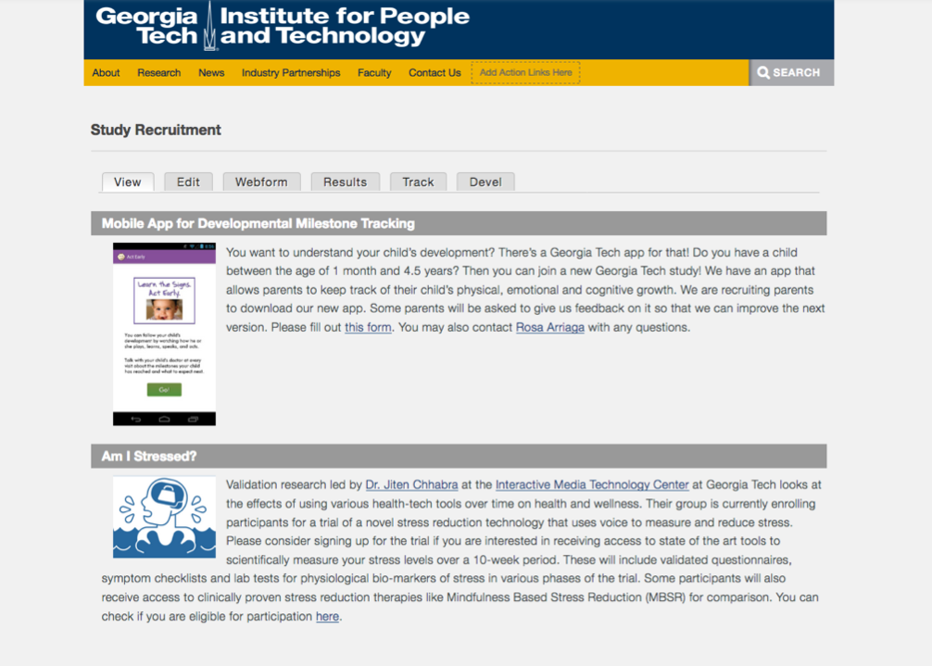
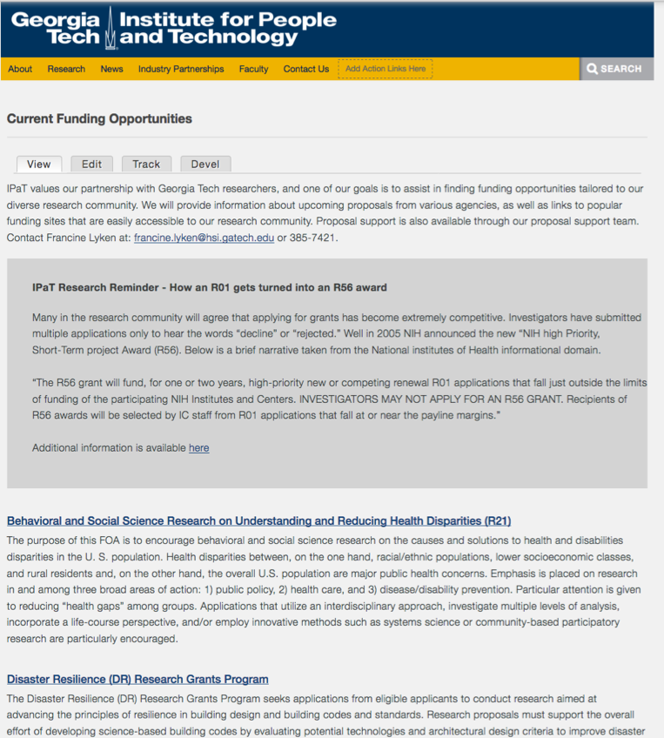
New on the IPaT website
-Study recruitment page
-Current funding opportunities (Francine Lyken - francine.lyken@his.gatech.edu)
*Reminder: Send your story ideas (Alyson Powell – alyson.powell@ipat.gatech.edu)

Slide 49
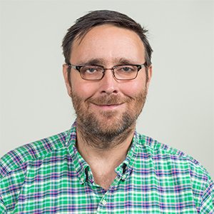
Ed Price
Project Manager of Federal Research Partnerships and Director of Research Partnerships in IPaT
Research Director in IMTC, one of the
co-founders of the Center, starting here as a student in 1989
Holds a number of patents in phonetic audio search and telemedicine networks
Co-Inventor of the fundamental technology behind Nexidia, a successful speech search company
Led many research efforts including award-winning Odyssey Online educational program
Was behind the proposed ITU H.350 for videoconferencing technologies
Project Director, Wireless RERC

